Slide 1
Spock
- Testing and Specification framework

Slide 2
Why make clean tests?
“If the discipline of requirements specification has taught us anything, it is that well-specified requirements are as formal as code and can act as executable tests of that code!” - Robert C. Martin

Slide 3
What we’ll talk about?
What is Spock?
Spock History
How to write simple test in Spock?
Data Driven testing
Interaction based testing

Slide 4
Spock is…
Developer testing framework
for Groovy and Java applications
Spock uses JUnitRunner i.e. Compatible with all Junit tools
Beautiful and highly expressive specification language - Groovy

Slide 5
Spock history
Created in 2008 by Peter Niederwieser (Gradle)
Joined by Luke Daley (Gradle)
Spock 1.0 released in 2015
Default test framework in Grails
Used internally by Gradle, Groovy

Slide 7
Why call it specification?

Slide 8
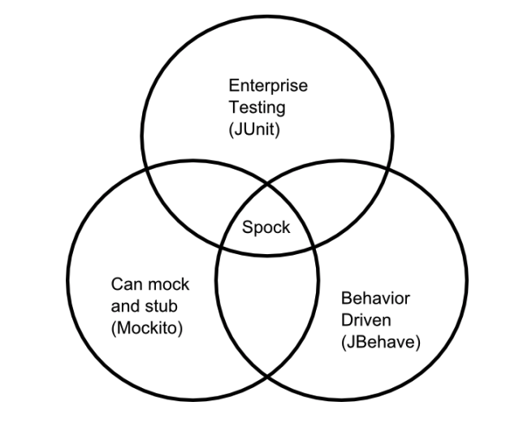
Why Spock?

Slide 9
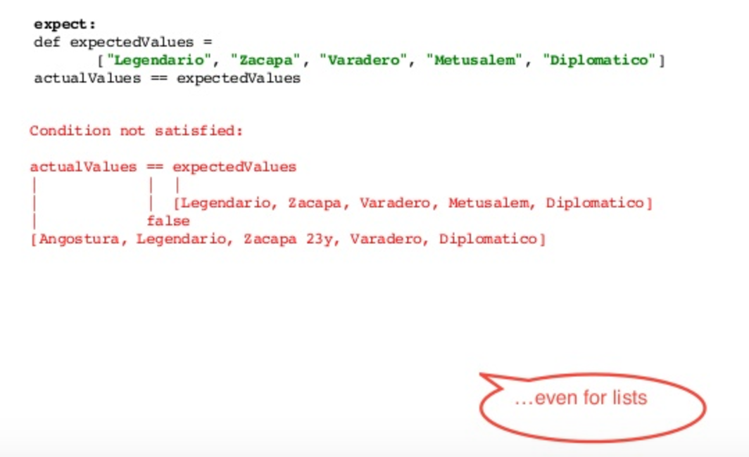
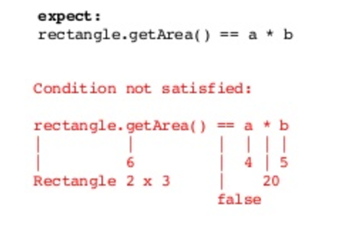
If you need more reasons..
Readability
Lines of test code is reduced
Test failures are very easy to debug

Slide 10
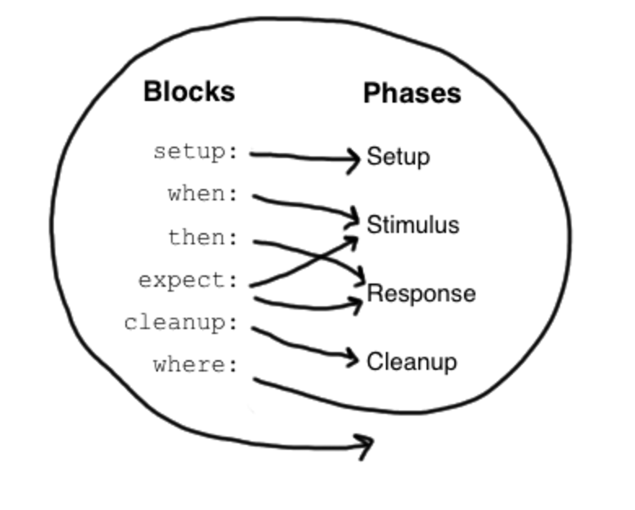
Blocks

Slide 11
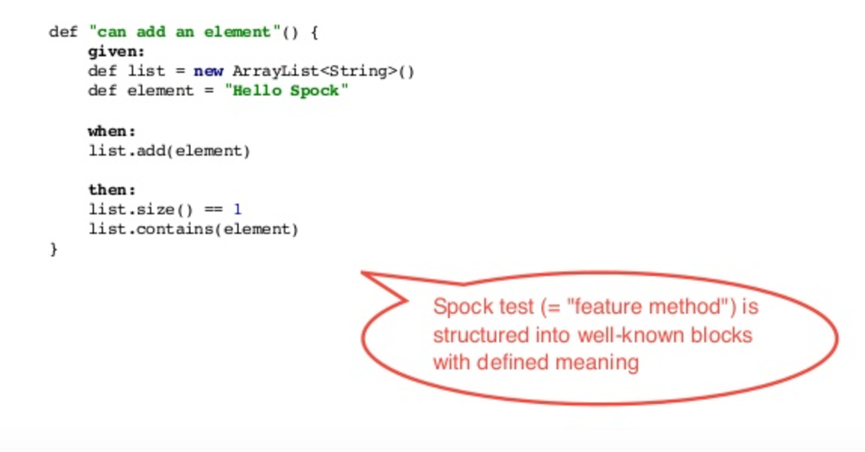
How a simple test looks like?

Slide 12
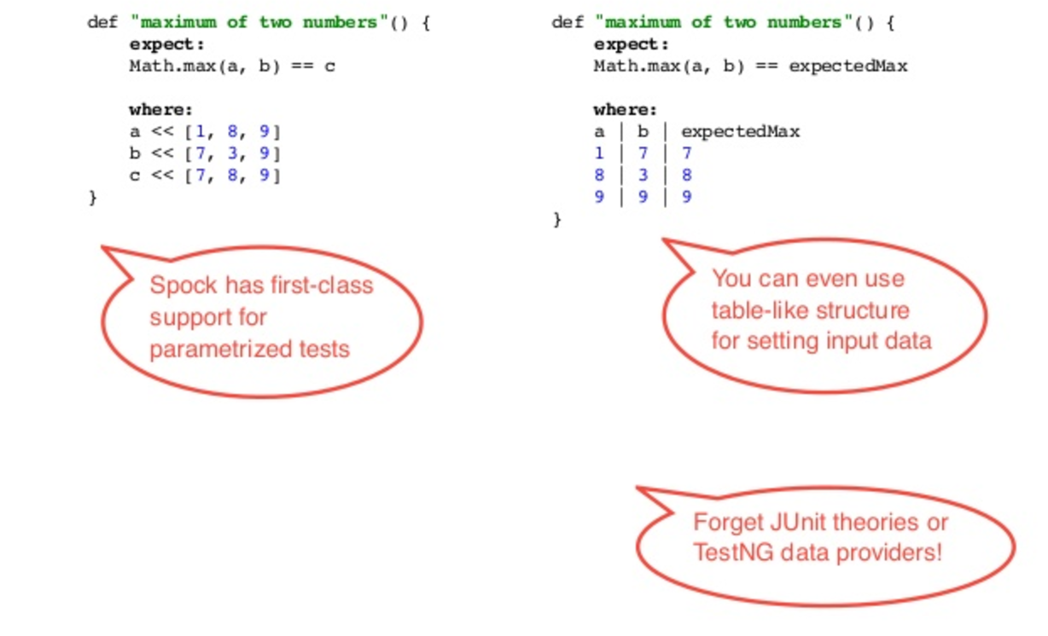
Data driven testing

Slide 13
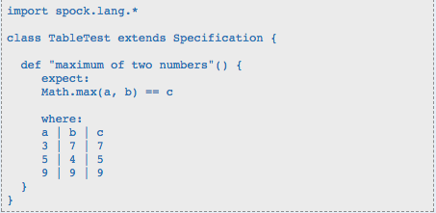
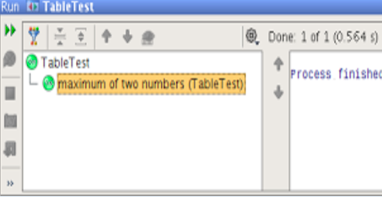
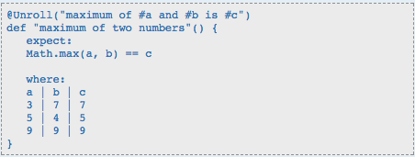
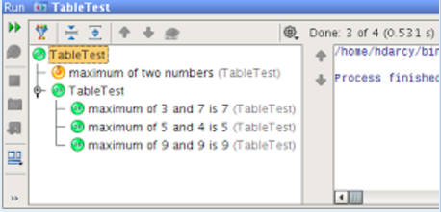
@Unroll

Slide 14
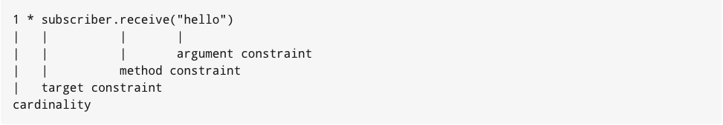
Interaction based testing – the Spock way!
it is simply a way to express which method invocations are expected to occur.

Slide 15
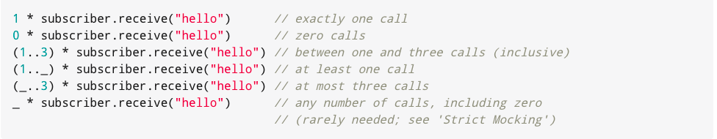
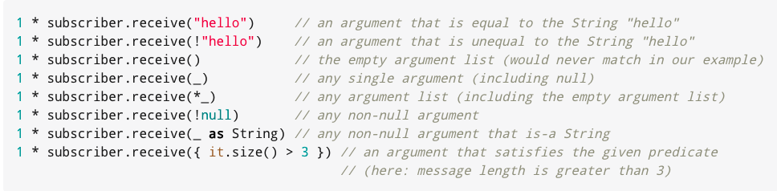
Example of Interactions

Slide 16
Checkout demo here - https://github.com/Vishal-Joshi/spock-demo

Slide 17
References
http://spockframework.org/
https://github.com/robfletcher/idiomatic-spock/blob/master/Idiomatic%20Spock.pdf
https://www.slideshare.net/danielkolman1/spock-27942005

